Slide 1
We will start at 9:50 on the dot. Now is a great time to ask me questions if you have any. Also, while we wait, please fill out the “Refresher Question” on Canvas!

Slide 2
Agenda
9:50 – 10:05
- Review the Canvas refresher question
- Start “Cat Factory” together
10:05 – 10:40
- Generating Random Data – Cat Factory
10:45 – 11:00
- Review the activity

Slide 3
Reviewing the Refresher Question
Other examples of probability models:
Rolling a die (outcomes 1-6, each with 1/6 probability)
Drawing a card from a deck (1/52 probability for each card)
Weather! (Depends on the day – e.g., 36% chance of rain)
Pretty much anything – you can create a probability model based on observations. How long does security take at the airport? Who is going to win an election?

Slide 4
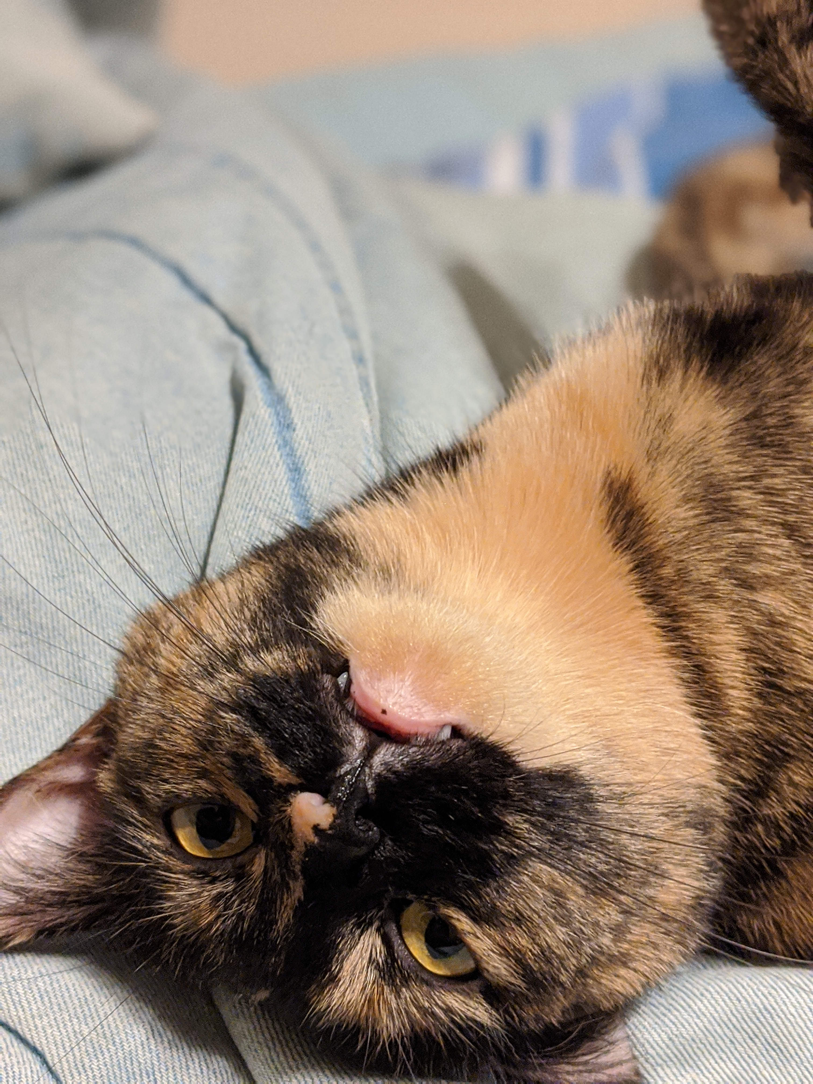
Generating Data -Cat Factories!
Today we are using a probability model to generate cats (among other things)
What you need:
Lab manual
TinkerPlots
Simulating Data.tp
Female-cat-names.tp

Slide 5
In your groups -
Review my answers to questions #1 - #4 together
Make 100% certain you do questions #5 and #6 (and ask us any questions)
Once you are done with #6, try to work through #7 – #12
Stretch Goal: Work through #13 - #20
Make sure to read ALL the instructions!!
Notes:
http://campuspress.yale.edu/infantlab/media/

Slide 6
Reviewing the activity – I will post my completed TinkerPlots and Lab Manual within the next day. I encourage you to work through this at home!

